Slide 1
Kerala Travel Guide Screenshots

Slide 2
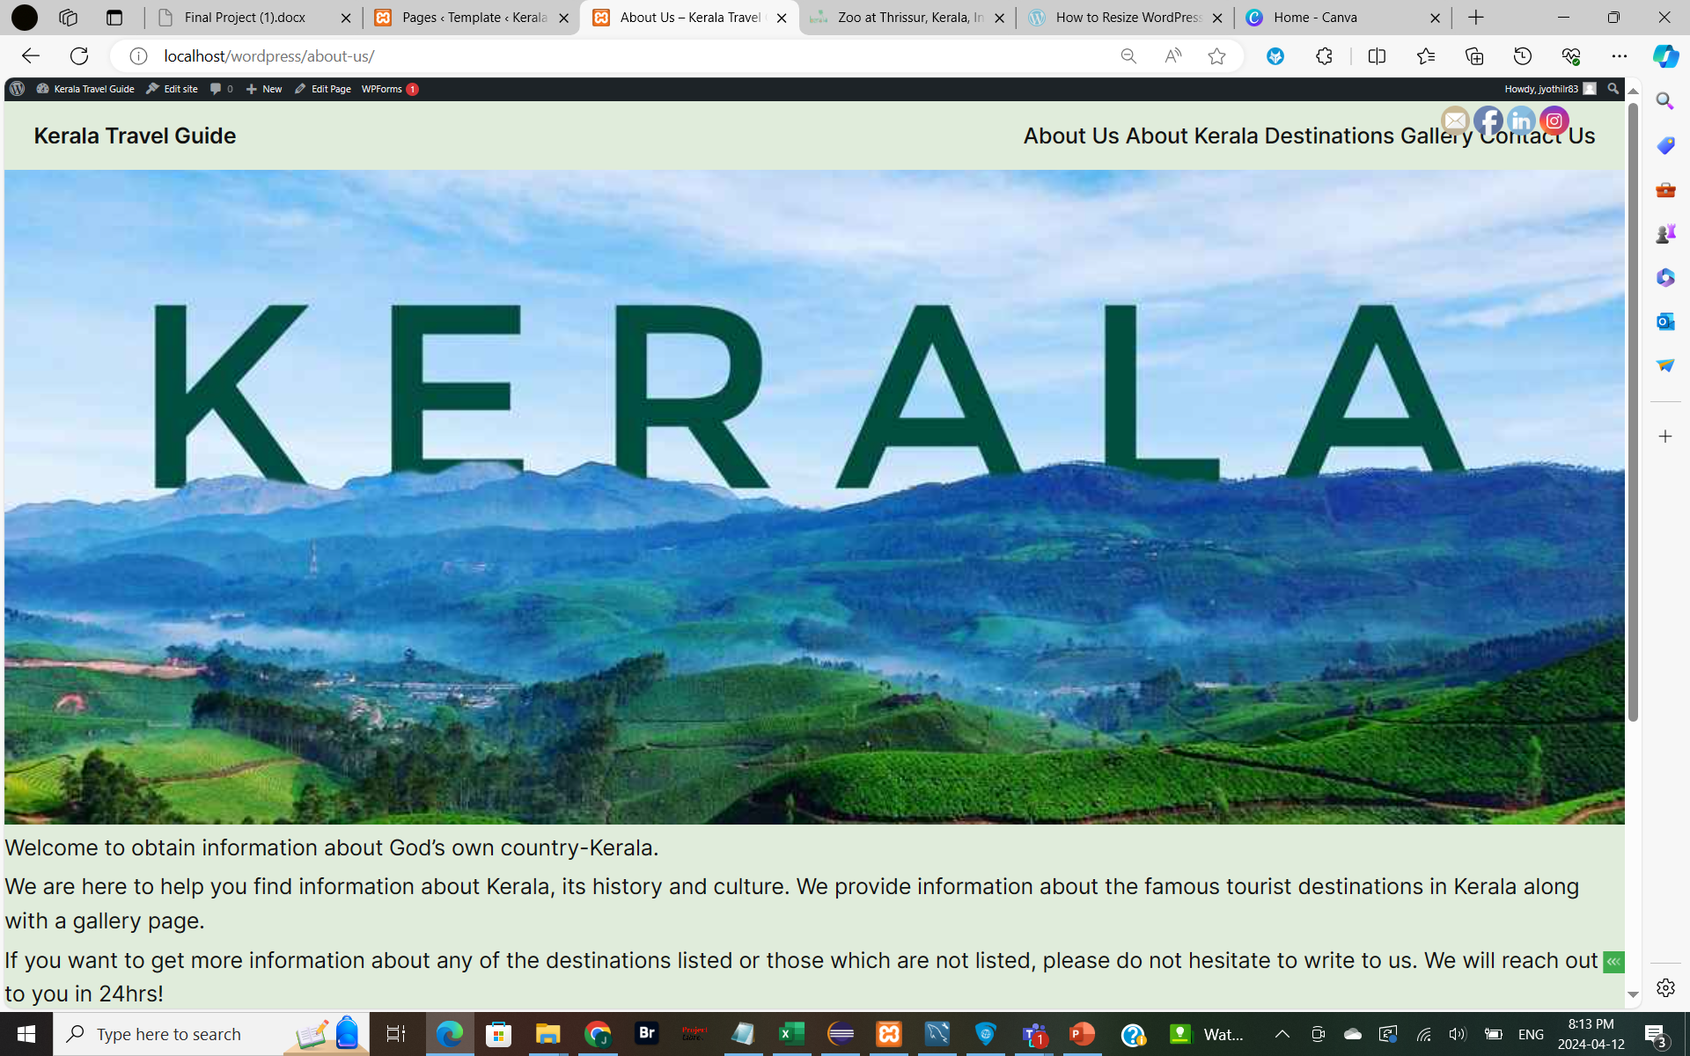
About Us Page

Slide 3
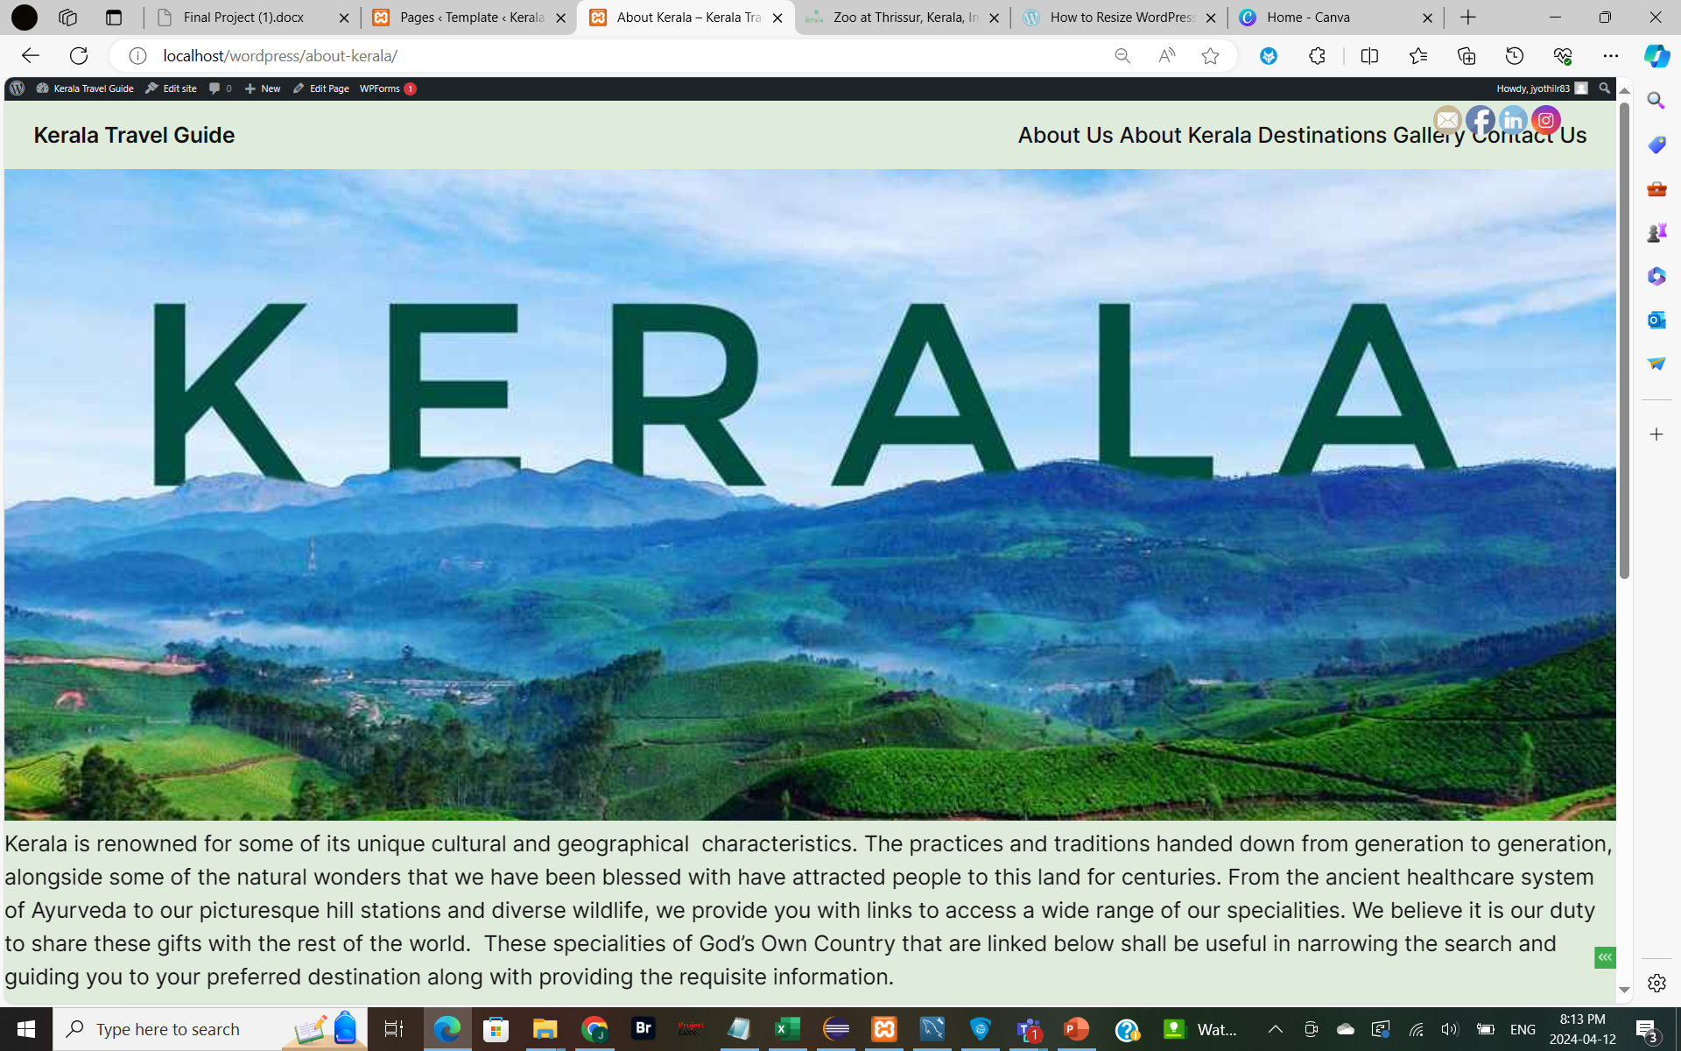
About Kerala Page

Slide 4
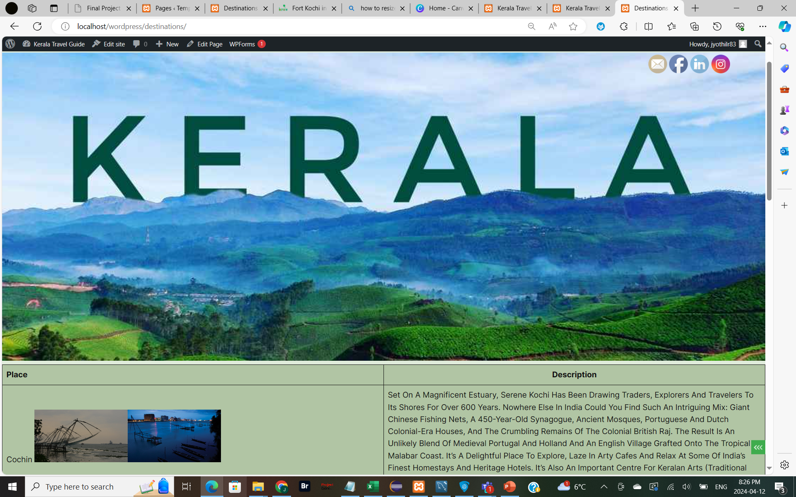
Destinations Page

Slide 5
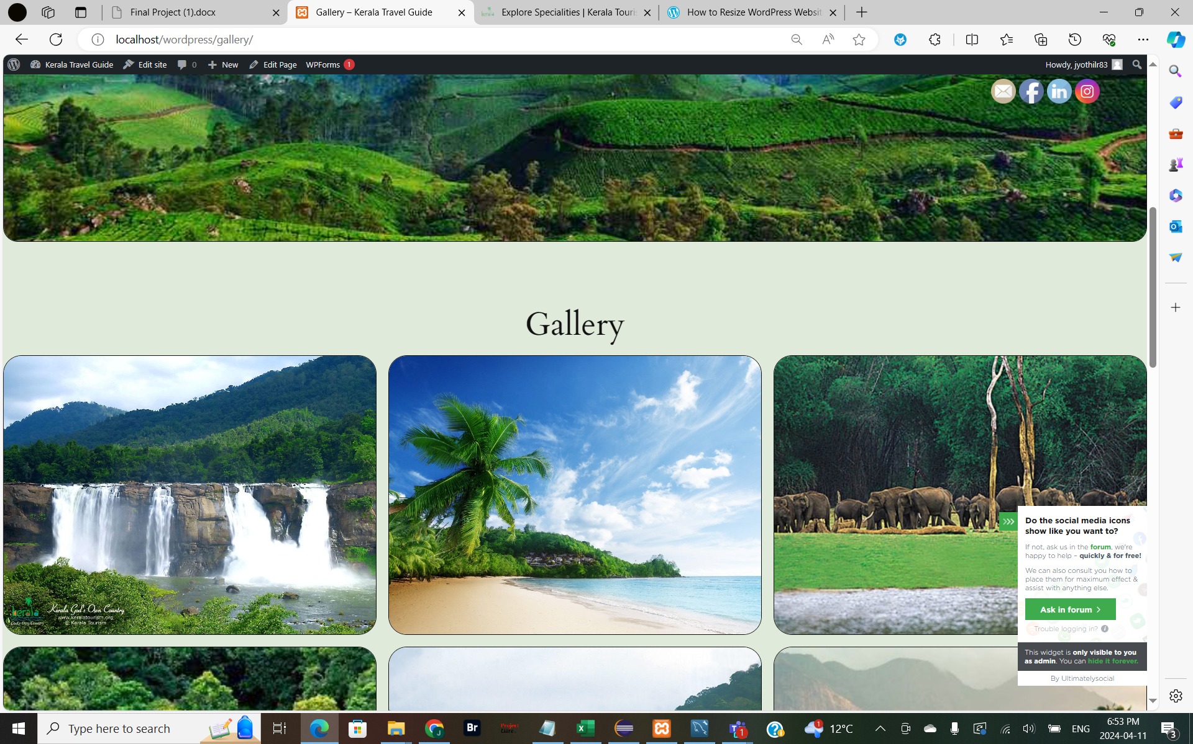
Gallery Page

Slide 6
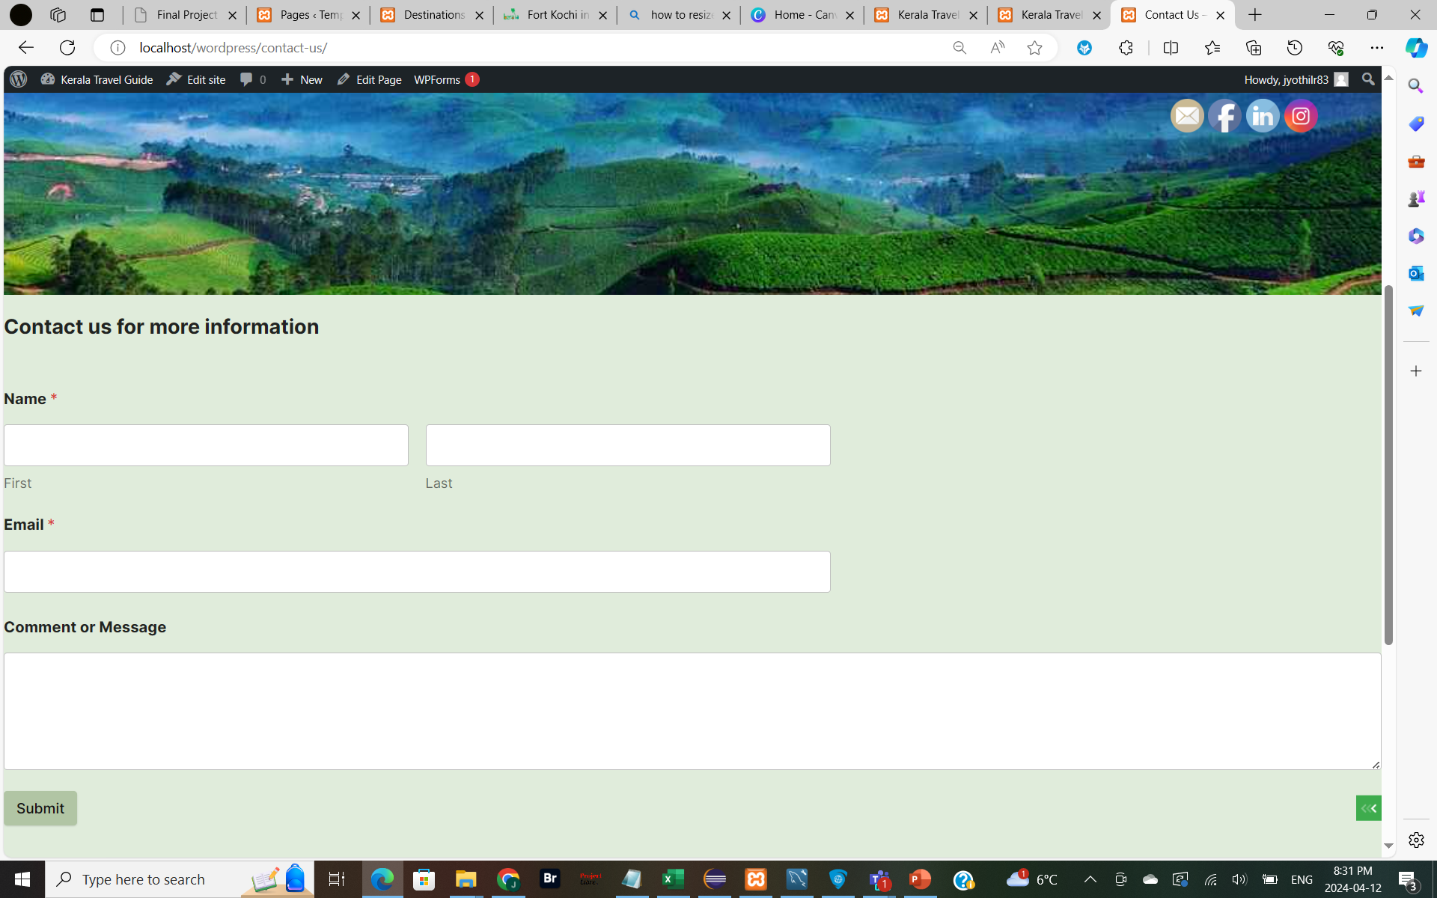
Contact Us Page

